Slide 1

Employment By Economic Activity & Labour Force Participation and Unemployment
Documentation

Slide 2
Table of content
Slide 3 Overview
Slide 4 Average Employment by Industry
Slide 5 Percentage Employment by Industry
Slide 6 Bottom 10 Regions by Total Value of Economic activities
Slide 7 Bottom 10 Regions by Labour force participation and unemployment
Slide 8 Labour force participation and unemployment
Slide 9 Percentage Labour force participation and unemployment
Slide 10 Observations & Conclusion
Slide 11 Recommendations.

Slide 3
overview
The dataset used for this documentation contains information on employment and economic activities across various regions and countries. It provides detailed statistics on different aspects of the labour force and employment by industry, broken down by gender.

Slide 4
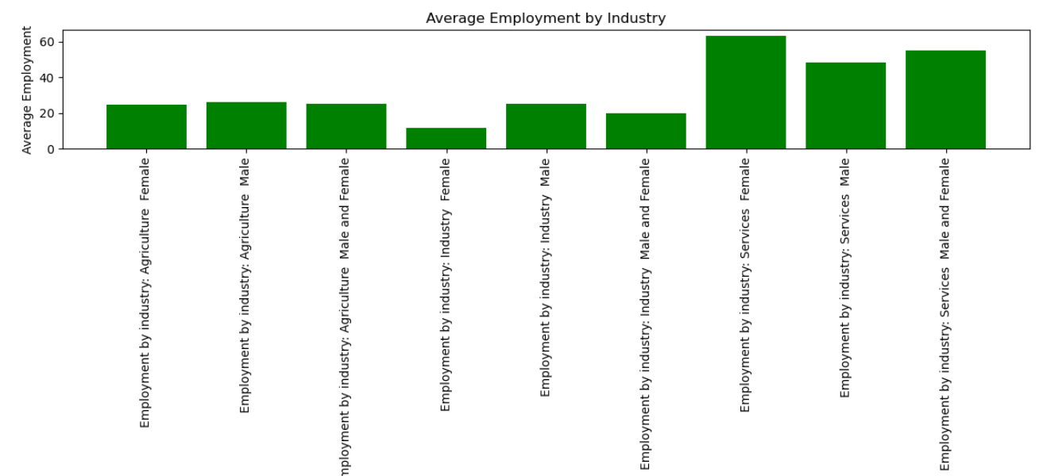
Average Employment by Industry

Slide 5
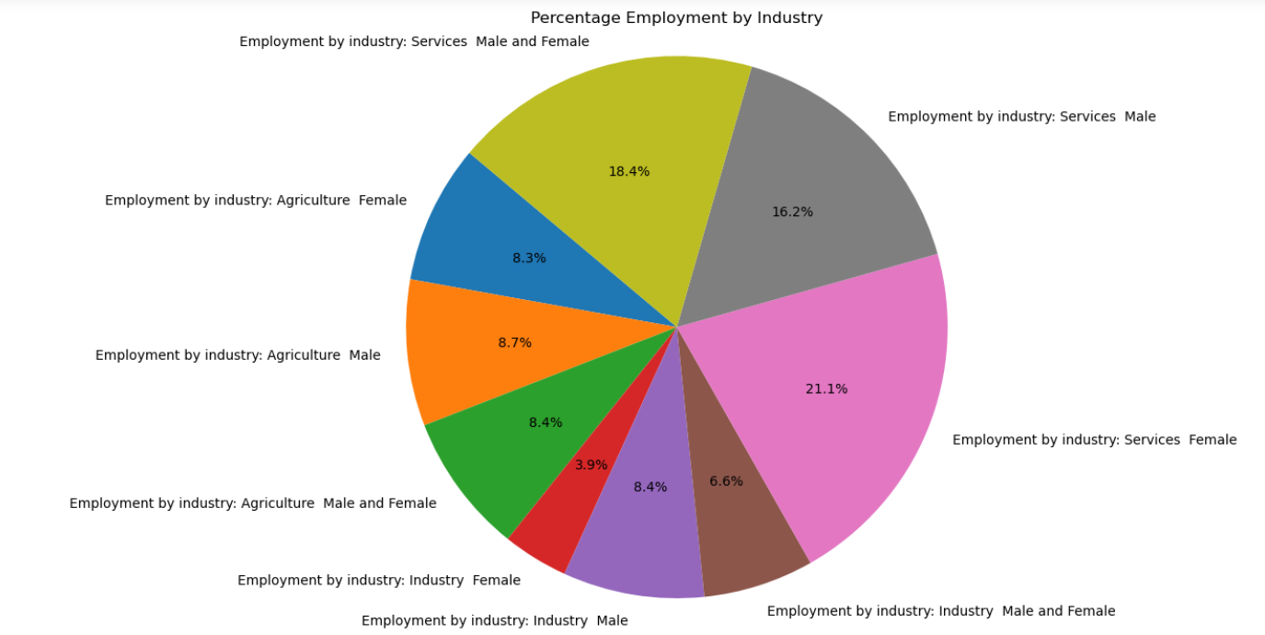
Percentage Employment by Industry

Slide 6
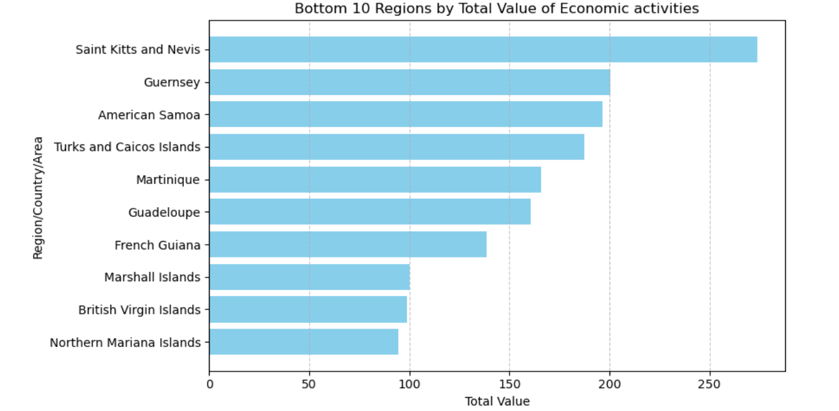
Bottom 10 Regions by Total Value of Economic activities

Slide 7
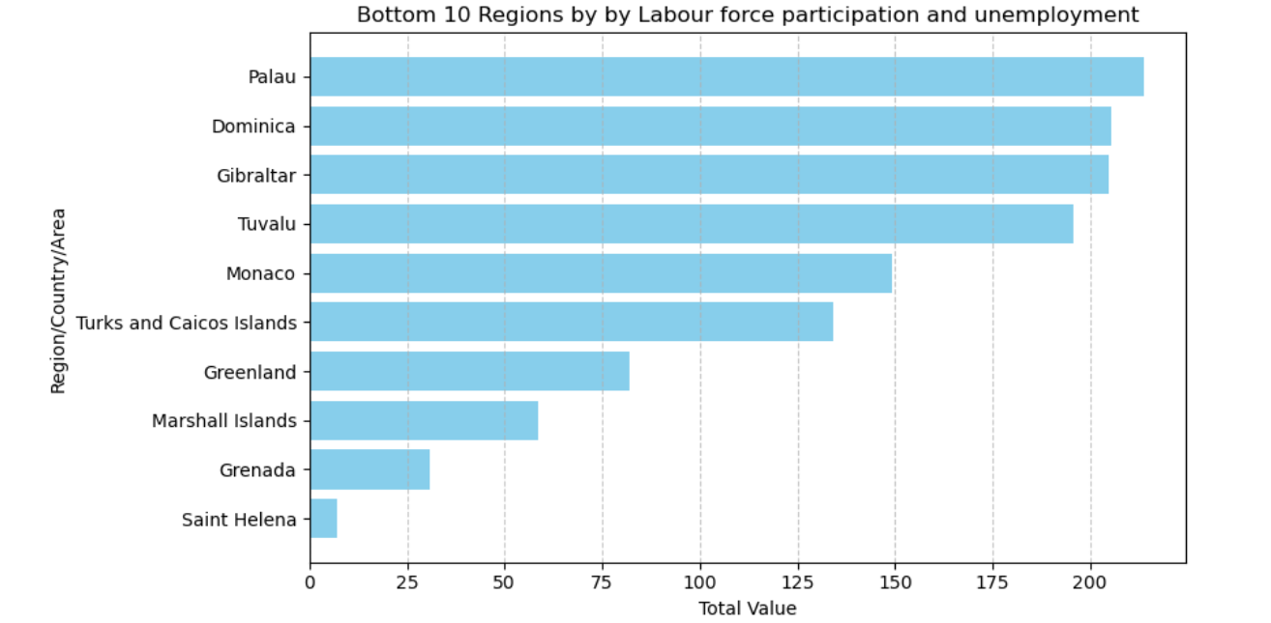
Bottom 10 Regions by Labour force participation and unemployment

Slide 8
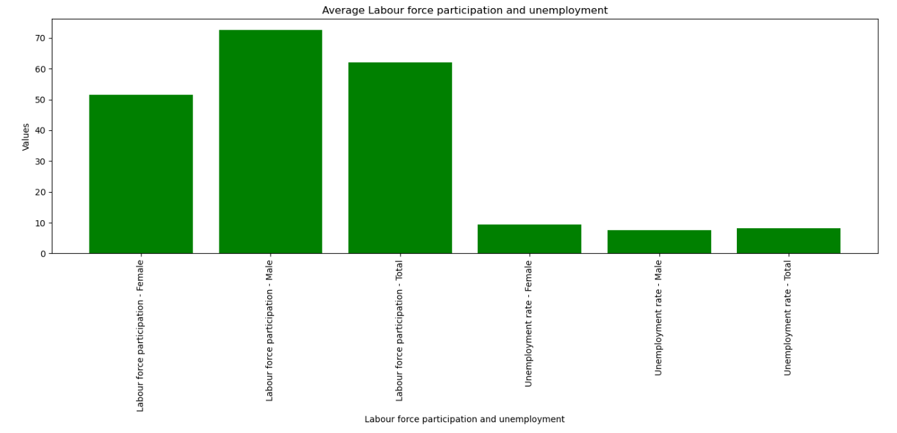
Labour force participation and unemployment

Slide 9
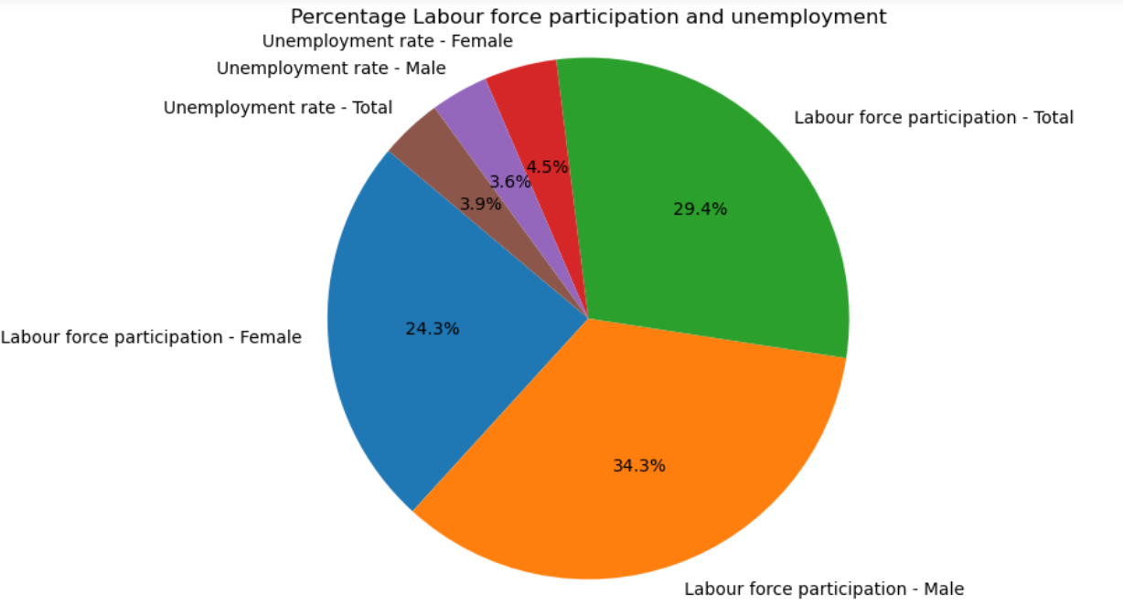
Percentage Labour force participation and unemployment

Slide 10
Observations & conclusion
24.3% of the female population is actively participating in the labour force. Male labour force is significantly higher, with 34.3% of the male population actively engaged in the labour force. The combined participation rate for both genders stands at 29.4%
4.5% of the female labour force is unemployed. 3.6 % of the male labour force is unemployed. The overall unemployment rate, combining both genders, is 3.9%.
Employment in agriculture is balanced between males and females, with a slightly higher participation for males. The overall percentage of employment in this sector is around 8.4
There is a significant gender disparity in the industrial sector, with male employment 8.4% being more than double that of female employment 3.9%.
The services sector shows a high level of employment, particularly among females 21.1% compared to males 16.2%. This sector has the highest employment rate overall.
The bottom 10 countries when it comes to economic activities are Saint Kits and Nevis, Guernsey, American Samoa, Turks and Caicos Islands, Martinique, Guadeloupe, French Guiana, Marshall Islands, British Virgin Islands, Northern Mariana Islands
Marshall Islands, British Virgin Islands and Northern Mariana Islands have the lowest economic activity among the countries, highlighting the need for significant economic interventions and improvements.

Slide 11
Recommendations
Investments in skill development programs specifically targeted at women to enhance their employability and productivity should be encouraged.
Policies that support female employment, such as maternity leave, childcare facilities, and flexible working hours should be implemented.
The government should ensure equal employment opportunities for both genders through anti-discrimination laws and practices.
There should be more focus on creating job opportunities in sectors that can absorb large numbers of unemployed individuals.
Vocational training and upskilling programs should be provided to help the unemployed, particularly those with outdated skills, to find new job opportunities.

